Slide 1
GPS Tracker
Project in a course BPC-IOT
Semenov Dmitrii, Radoslav Tomčala

Slide 2
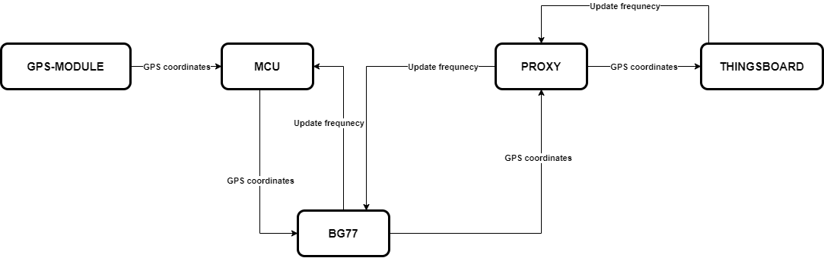
Task statement
Naprogramujte a zprovozněte GPS Tracker pro sledování a monitorování vozidel a zásilek
Předpokládejte:
• Převoz zboží a provoz vozidel po České a Slovenské republice.
• Dle zadávací dokumentace, zařízení nesmí být připojeno na napájecí soustavu vozidla.
GPS Tracker bude vysílat v definovaných intervalech (min 30 minut) polohu vozidla/zboží.
V případě krádeže monitorovaného zboží/vozidla bude mít operátor možnost vzdáleně
změnit interval odesílání dle vlastního uvážení do minima 1 minuty.
Poloha zařízení bude zobrazena na platformě Thingboard.

Slide 3
Technology overview
Used communication technology: NB-IoT
NB-IoT Overview:
Low power consumption (especially in PSM mode 10uA vs 15mA in IDLE)
Lower costs
Efficient use of RF spectrum
Possible rollout lag times (doesn’t matter for a device with 1|30 min transceiver interval)
Lower data transmission (short message(approx. 40 symbols) once in 1|30min, doesn’t matter)
Higher latency (delay up to 10s doesn’t matter for our task)

Slide 4
Protocol overview
According to the project guidelines, a preferred protocol is UDP due to the transferred data volume, which is charged.
ThingsBoard use requirement => need to use MQTT or CoAP protocol for communication.
As a result, we asked for a PROXY server(made by Ing. Radim Dvořák) that receives UDP protocol commands and transforms them into the MQTT commands, which are then sent to the ThingsBoard. The PROXY server also transmits the switch state change back to the transmitter board (for fast-tracking mode activation).

Slide 5
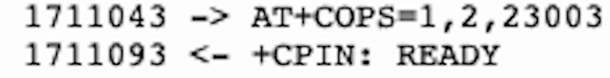


Code overview: Initialization (1/3)
# Set radio mode and APN configuration
module.setRadio(1)
module.setAPN("lpwa.vodafone.iot")
# Connect to the network
module.sendCommand("AT+COPS=1,2,23003\r\n")
# Open socket
module.sendCommand(f"AT+QIOPEN=1,1,\"UDP\",\"{_REMOTE_SERVER_IP_PROXY_}\",{_REMOTE_SERVER_PORT_PROXY_}\r\n")
# Check network registration status using AT+CEREG?
cereg_response = module.sendCommand("AT+CEREG?\r\n")
# Enable PSM mode
module.sendCommand(f"AT+CPSMS=1,,,\"00000100\",\"00001000\"\r\n")
# Period TAU = 40 min, Active time = 16 sec

Slide 6
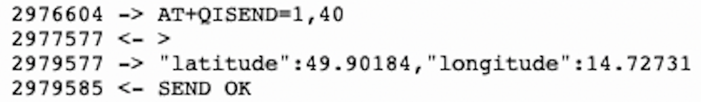
Code overview: GPS data (2/3)
# Send message
latitude, longitude = coordinates[a]
gps_data_vector = f"\"latitude\":{latitude},\"longitude\":{longitude}"
module.sendCommand(f"AT+QISEND=1,{len(gps_data_vector)}\r\n")
time.sleep(2)
module.sendCommand(gps_data_vector + "\r\n")
a = a + 1
if a == coordinates_num:
a = 0
GPS Issue:
We couldn’t use the GPS module BG77 (we tried, but every time we request coordinates, it returns an error that the GPS service isn’t available). We also wanted to use an external GPS module, but for UART communication with this sensor, we would have to solder the output of BG77 on the board.
=> We decided to use an array of pre-generated GPS data, which can be further replaced

Slide 7
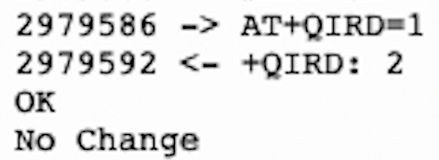
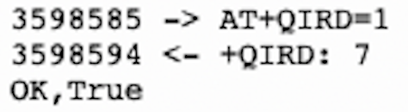
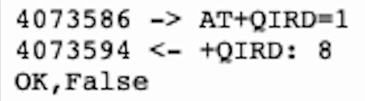
Code overview: RX mode (3/3)
message = module.sendCommand(f"AT+QIRD=1\r\n")
splt_message = message.split(",")
if len(splt_message) == 2:
if splt_message[1] == "True\r\n\r\nOK":
_SENDING_INTERVAL_ = _SENDING_INTERVAL_T_
message = "Switch set to ON position"
elif splt_message[1] == "False\r\n\r\nOK":
_SENDING_INTERVAL_ = _SENDING_INTERVAL_F_
message = "Switch set to OFF position"
else:
message = "Not a expected response."
else:
message = "No Change"
RX Issue:
There is a one-message delay in the communication
=> Changing the mode of transmitting the location isn’t instant

Slide 8
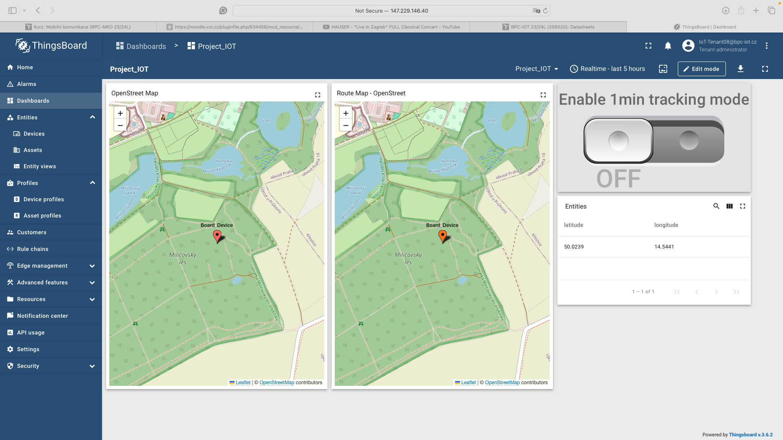
ThingsBoard dashboard

Slide 9
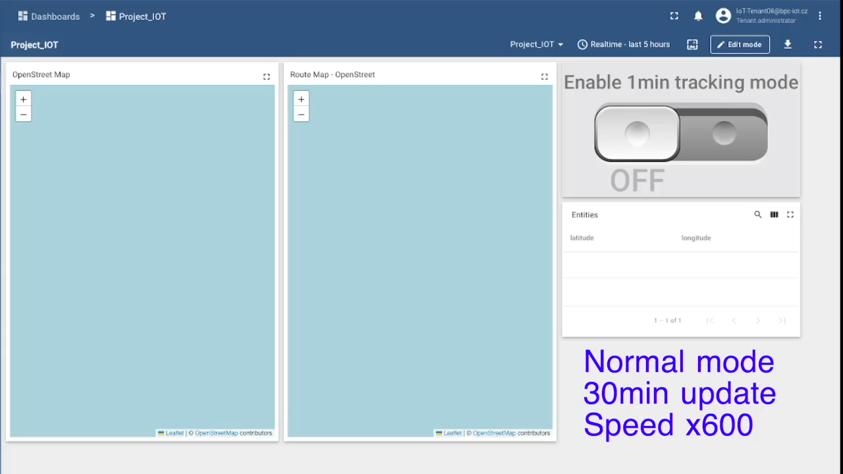
Video demonstration

Slide 10
Current consumption

